Slide 1
DATA ANALYSIS AND MACHINE LEARNING USING PYTHON INTERNSHIP MOBILE PRICE CLASSIFICATION BY TEAM PRAJJWAL CODES
TEAM NUMBER- 9
PRAJJWAL MAURYA

Slide 2
OVERVIEW
PROBLEM STATEMENT
DATASET DESCRIPTION
DATASET PREPROCESSING
DATASET VISUALIZATION
CORRELATION
MACHINE LEARNING MODEL
Logistic Regression
Decision Tree
CONCLUSION

Slide 3
PROBLEM STATEMENT
A person wants to establish a new mobile company in India. He wants this company would give tough competition to the other tech giants in the market. But he does not know how to estimate the price of mobiles that his company will create.
Basically in this market, we cannot simply assume the prices of the mobile phones so he needs a way to calculate the price of mobile phones that his company will create.
If this task is performed manually, it would take months to research the market and come up with the price for a certain mobile phone.
So he needs a way to get this work done with the help of Machine Learning.

Slide 4
DATASET DESCRIPTION
The dataset which is being used in this project is taken from kaggle which contains attributes as the data of the mobile phones which are already present in the market.
The attributes of this dataset are basically the specifications of the mobile phones which are listed below.
Battery- Battery in mAh
Clock Speed- Clock speed of the processor
Dual sim- Dual sim availability (yes or no)
Front camera- Front camera in megapixels
Internal memory- Internal Memory in GB
4G- 4G facility (yes or no)
Mobile depth- width of mobile (in cm)
Mobile weight- Weight of mobile in grams
Primary camera- Primary camera in megapixels

Slide 5
RAM- Ram of the mobile set in MB
Screen resolution- contains two subpart height and width in pixels
Number of cores- Number of cores present in the processor
Screen height and width- height and width in cm.
Talk time- Total talk time (in hrs)
3G- 3G facility (yes or no)
Touch screen- touch screen facility (yes or no)
Wi-Fi- Wi-Fi facility (yes or no)
Price range- used as output (0,1,2,3)
There are in total 2000 mobile phones data present in the dataset, based on these data we are going to predict the price range of our mobile phone.
OUTPUT- The output for this dataset and our model will be in integer as 0,1,2,3

Slide 6


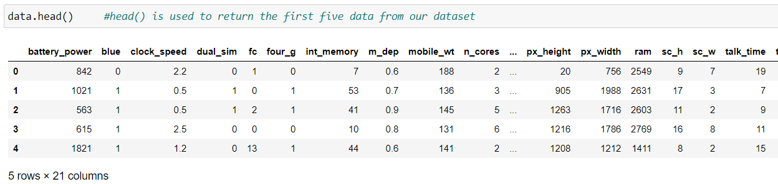
DATASET PREPROCESSING
Importing the modules/packages required for preprocessing of
the data.
Loading the dataset .
showing the first five
rows of our dataframe.

Slide 7
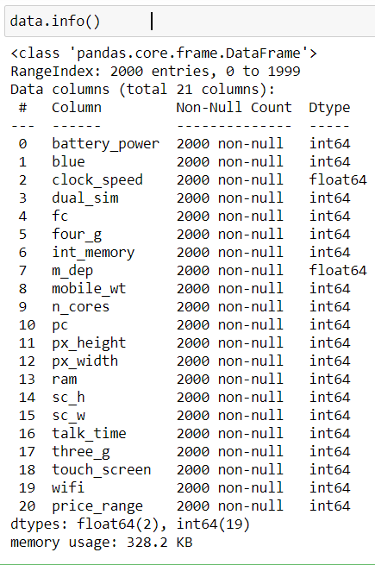
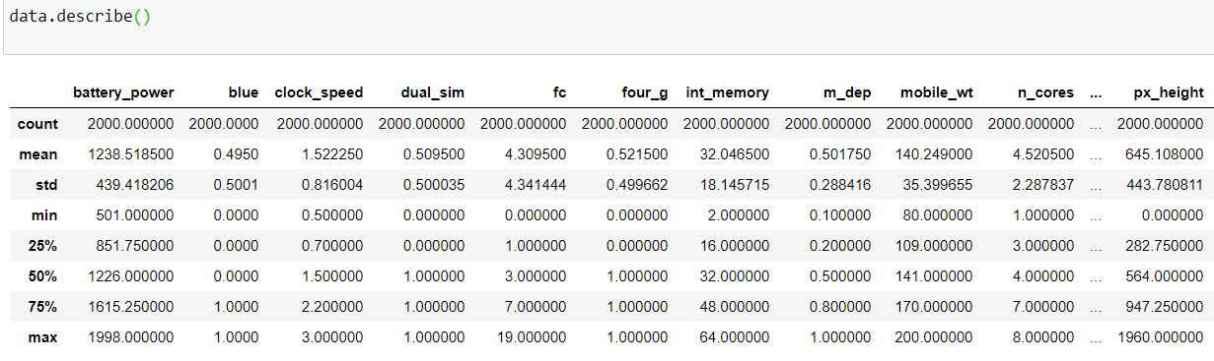
Describing data in multiple way
Using info method
Using describe method
Info method tells us the basic information of our dataset
Describe method tells the statistical information about our dataset like mean, median, mode, min, max etc.

Slide 8
Formatting of the dataset.
Formatting of the dataset is not
required since all the values are
compatible with each other.

Slide 9
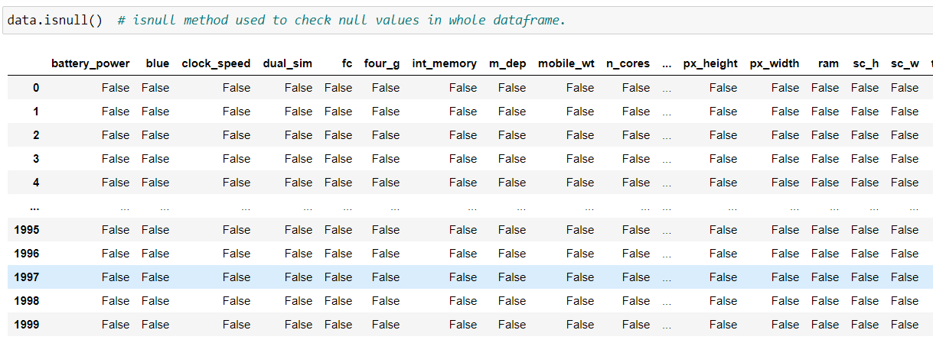
Checking for the null values.
There are no null values in our dataset.

Slide 10
Summary of preprocessing of data.
From above analysis we can conclude that-
There are no null or missing values in our dataset.
All the data in each attribute is compatible with each other.
There are no insignificant column.

Slide 11
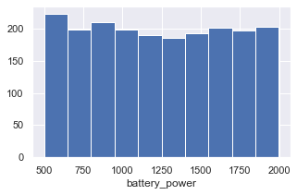
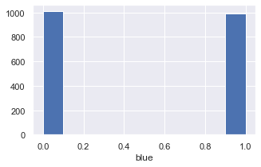
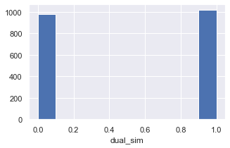
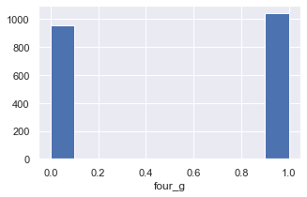
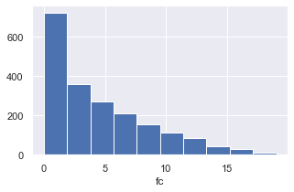
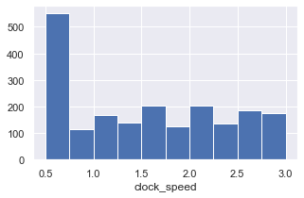
DATA VISUALIZATION Following is the graphical analysis of every attribute.
battery_power is a quantitative data. Number of phones for increasing battery power is almost same.
Dual_sim is a categorical variable where 0 is numerical code for False and 1 is for True.
fc is a quantitative variable, and as megapixels is increasing we see no of mobile phones is decreasing.
blue is a categorical data where 0 is numerical code for False and 1 is for True.
four_g is a categorical variable where 0 is numerical code for False and 1 is for True.
clock_speed is a quantitative data.

Slide 12
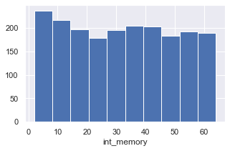
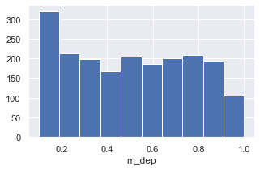
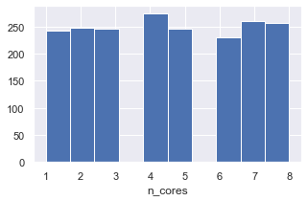
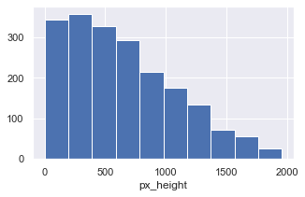
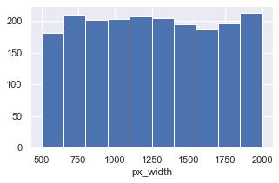
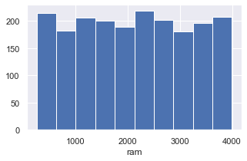
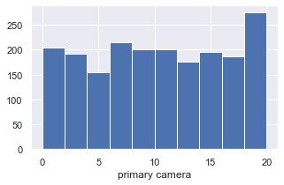
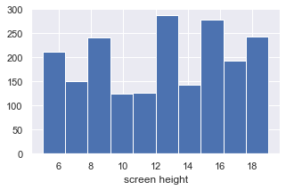
int_memory is a m_dep is a
quantitative data. Quantitative data.
n_cores is a px_height is a
quantitative data. quantitative data
px_width is a ram is a quantitative
quantitative data. data.
primary camera screen height or sc_h
or pc is a is a quantitative data.
quantitative data.

Slide 13
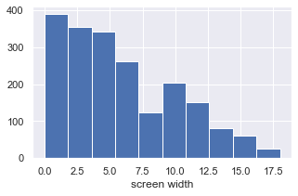
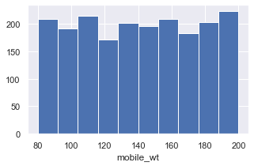
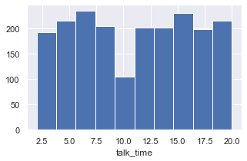
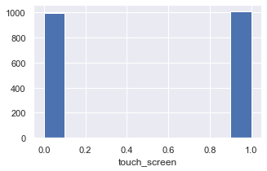
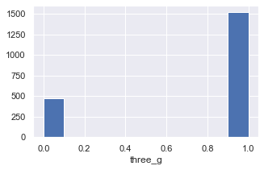
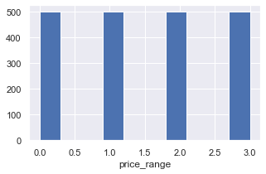

screen width is a mobile_wt is a
quantitative data. uantitative data quantitative data.
talk_time is a
quantitative data.
touch_screen is a
categorical data.
three_g is a
quantitativ e data. quantitative data.
price_range is a
categorical data.
wifi is a categorical This is our output.
data.

Slide 14
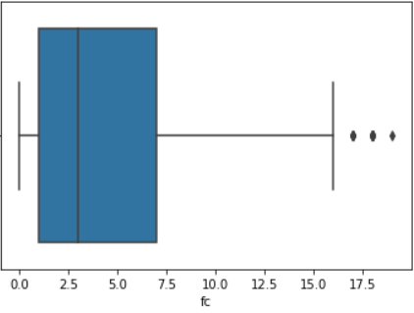
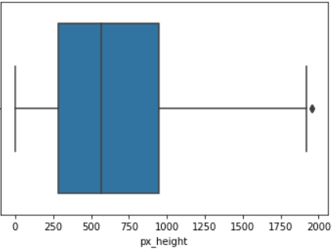
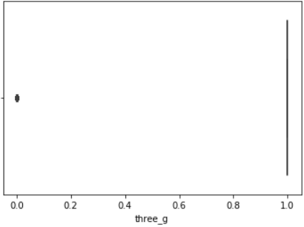
OUTLIERS- Outliers are extreme values that deviate from other observations on data , they may indicate a variability in a measurement, experimental errors or a novelty. In other words, an outlier is an observation that diverges from an overall pattern on a sample.
Following outliers are shown below with the help of visualization.
Three attributes have outliers namely fc, px_height, three_g

Slide 15
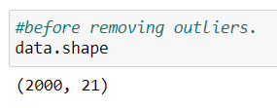
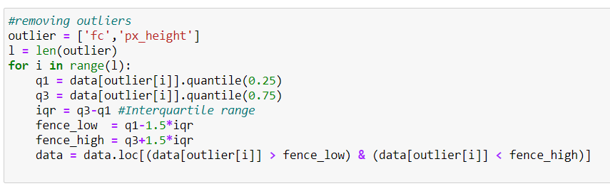

Shape of data before removing
outliers.
Removing
outliers.
Shape of data after removing
outliers.
Note: Here outliers of the three_g attributes are not removed because it serves important role in training our model.

Slide 16
CORRELATION
Correlation matrix for dataset- Correlation matrix shows the correlation between every attributes to every attributes. In correlation matrix, value ranges from -1 to 1. The correlation coefficient closer to boundary values (-1 to 1) shows higher correlation between the variables and are considered relevant. Whereas, closer the values to 0 lesser the correlation between the variables. The negative sign shows the inverse relation between the attributes or variables and the positive shows the direct relation between the attributes or the variables.

Slide 17
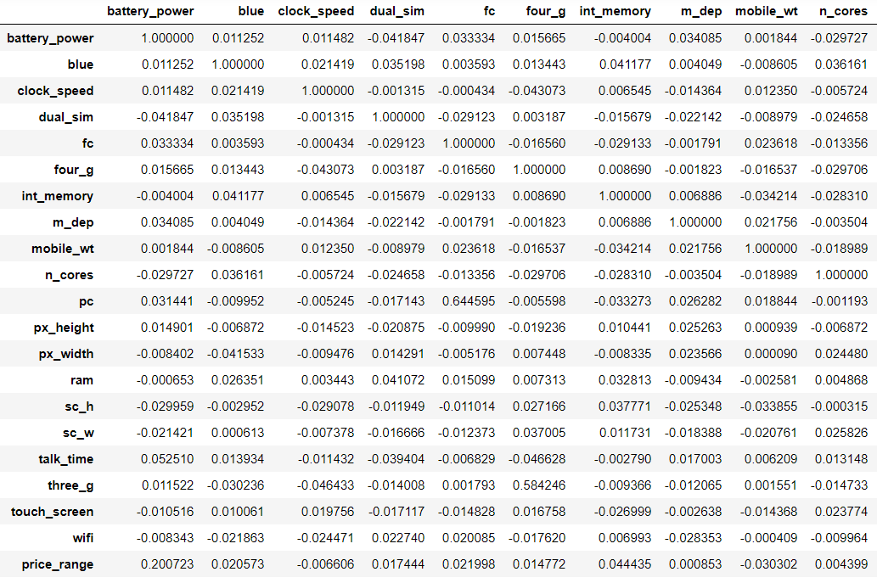
Correlation matrix of our dataset.

Slide 18
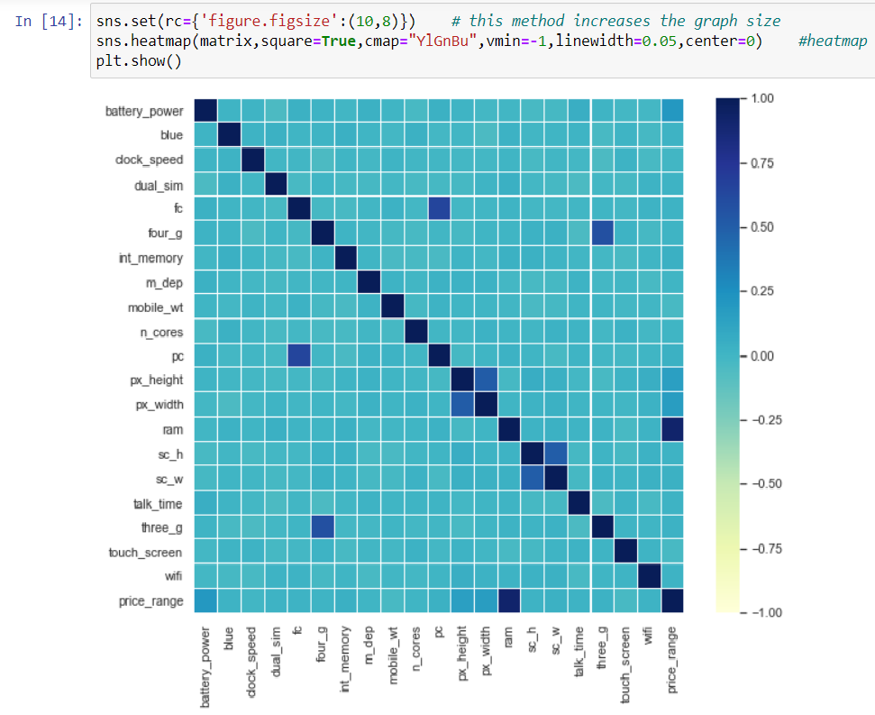
Heat map to visualize the correlation between the attributes.

Slide 19
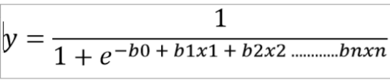
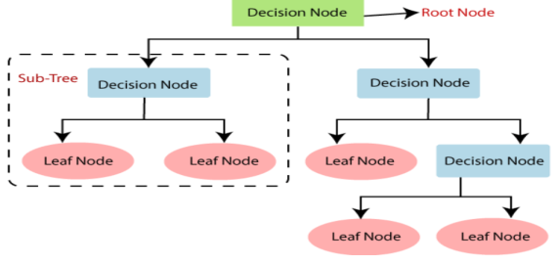
MACHINE LEARNING MODEL
For our project we will be applying two machine learning algorithms-
Logistic Regression- The logistic regression is a statistical technique used to predict the probability of a certain situation or certain cases or events as True/False or 0/1. This can be extended to situations where there can be more than one result. For e.g. determining whether the image contains dog, cat or lion.
Equation:
where b₀ is intercept and b₁ , b₂ ,…,b_{n} coefficients of variables.
Decision Tree- Decision Tree algorithm is a technique used to predict the class or value of the target variable by learning simple decision rule inferred from prior data (training dataset) .

Slide 20
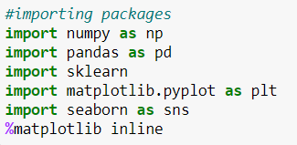
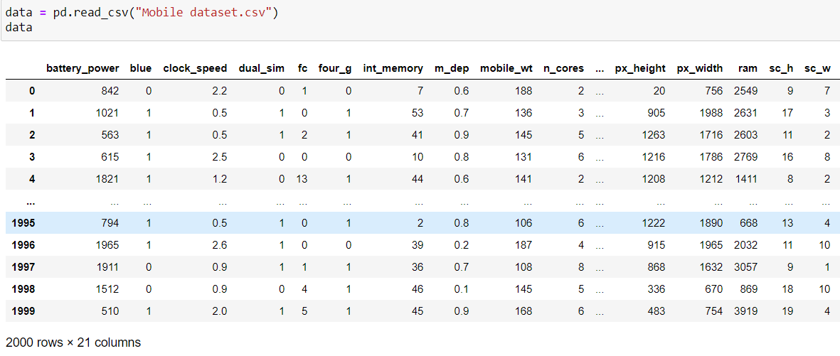
LOGISTIC REGRESSION
Importing all the packages and modules.
Loading the dataset.

Slide 21


Declaring the dependent variable and independent variables. Here “x1” contains all the independent variables (battery_power, blue, wifi, etc.) and “y1” contains dependent variable (price_range).
Splitting the dataset into test and train data. test_size is an attribute used to determine the size of the test dataset. Here test_size = 0.2 means that 20% data is used for testing and 80% is used for training our model. random_state is a feature which is used to ensure that the split we generate are reproducible.

Slide 22
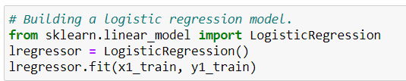

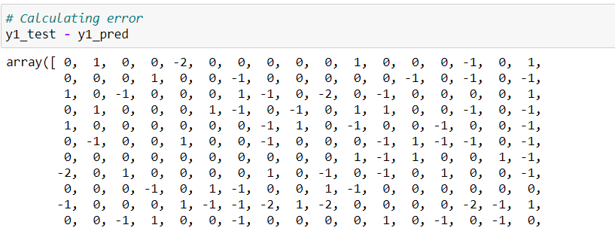
Building a multiple regression model
and fitting our training dataset to train
our model.
Predicting the results by putting in the
test dataset.
Calculating the error by subtracting predicted value from actual value.

Slide 23
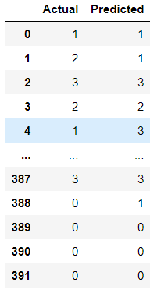
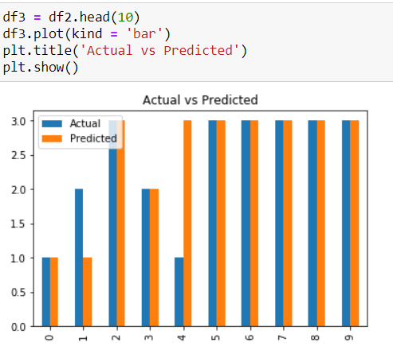
Comparison between the predicted value and test value through dataframe and graph. The graph shows the first 10 comparisons of predicted vs actual values.

Slide 24
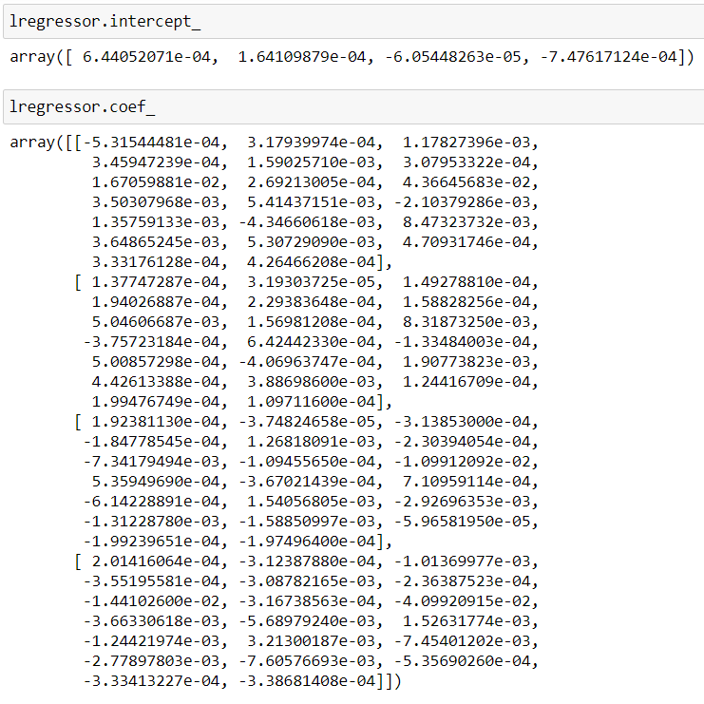
Calculating the intercept and coefficients of the equation.

Slide 25
DECISION TREE
Importing all the packages and modules.
Loading the dataset.

Slide 26
Declaring the dependent variable and independent variables. Here “x2” contains all the independent variables (battery_power, blue, wifi, etc.) and “y2” contains dependent variable (price_range).
Splitting the dataset into test and train data. test_size is an attribute used to determine the size of the test dataset. Here test_size = 0.2 means that 20% data is used for testing and 80% is used for training our model. random_state is a feature which is used to ensure that the split we generate are reproducible.

Slide 27
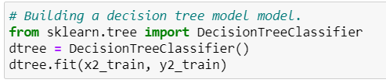

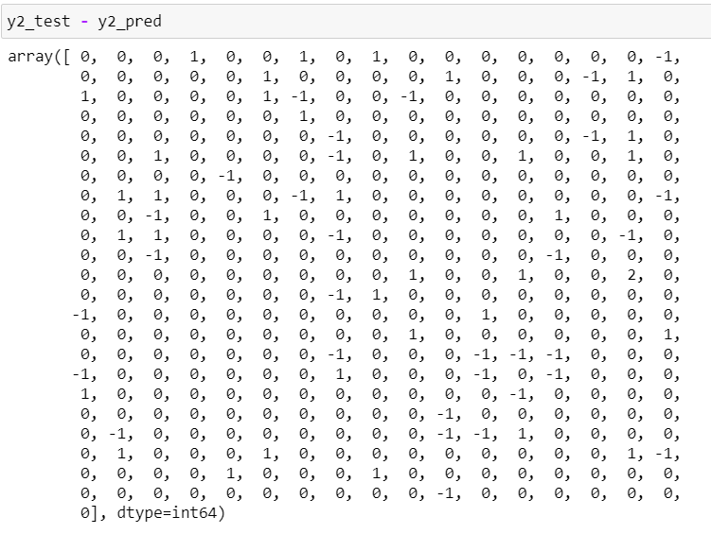
Building a multiple regression model
and fitting our training dataset to train
our model.
Predicting the results by putting in the
test dataset.
Calculating the error by subtracting predicted value from actual value.

Slide 28
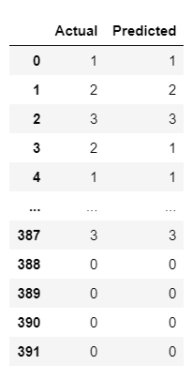
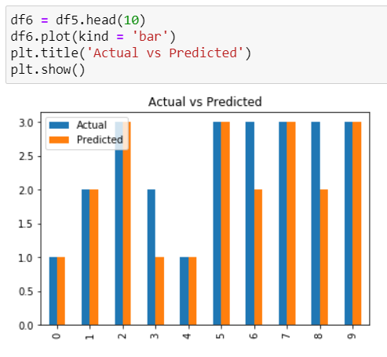
Comparison between the predicted value and test value through dataframe and graph. The graph shows the first 10 comparisons of predicted vs actual values.

Slide 29
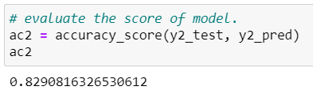
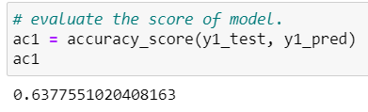
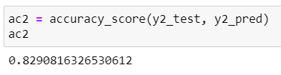
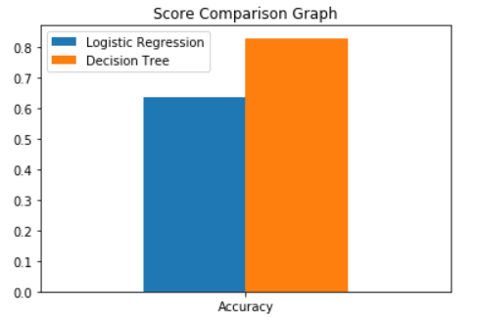
Comparison of Accuracy of both model
Decision Tree
Logistic Regression
ACCURACY = 82.90%
ACCURACY = 63.77%
Accuracy of Decision Tree > Accuracy of Logistic Regression

Slide 30
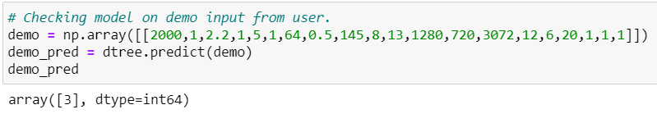
OUTPUT OF DECISION TREE
Since the accuracy of Decision Tree model is higher than logistic regression so we take Decision Tree for classification of price of mobile prices.
Testing our model on User provided data.
On providing the demo data from the user we see the prediction of our model.

Slide 31
THANK YOU

